Slide 1

Data MINING CA 2 Analysis on Real Time election result
ANAND TRIPATHY (10527557)

Slide 2
INTRODUCTION
The dataset describe Portuguese legislative election of 2019 which was held on 6 oct, 2019 for 230 seats for assembly of the republic. Concerning the results of the 27 parties involved in the electoral event.
It contains information about territory name, total and available mandates, blank or null votes, number of party, number of votes, final mandates etc. As the dataset was released for predictive modelling tasks, mostly focused on numerical forecasting tasks.
Our Objective is to find the votes per party and finding the clusters of the party using CRISP-DM Methodology.

Slide 3
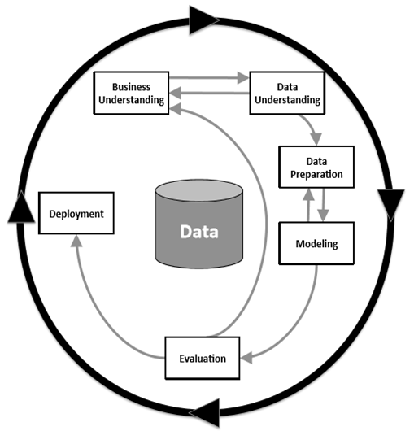
CRSIP-DM Methodology
We are using Data Mining techniques to understand the votes division and clusters detection of the parties. For this, CRISP – DM methodology is used which consist of following steps.
Business Understanding
Data Understanding
Data Preparation
Modelling
Evaluation
Deployment

Slide 4
Business Understanding
Business Understanding focuses on the project idea with respect to business perspective. User is expected to familiarize with the data before proceeding with its handling. It is the most important phase of the project involving establishing business objective, understanding scenario, determining mining goals and developing the project plans.
Our Business Objective:
Analysis on data is derived from various political parties.
To predict the political parties knowing by their total votes and their percentage
To determine which Machine learning algorithm techniques gives a better accuracy with the same set of data.
Determine the number of clusters that will fit into the dataset by using unsupervised learning model
Visualization of complete dataset according to the Party by covering as much various as can.

Slide 5
Data Understanding
This phase starts with collecting data and identifying data quality problems. We create initial insights and find subsets to form hypotheses. In Dataset, it contains 21643 observations and 28 features with mixture of categorical and numeric values in nature and no null values. And we have use multiple visualization plot to observer the trend, pattern for data understanding.

Slide 6
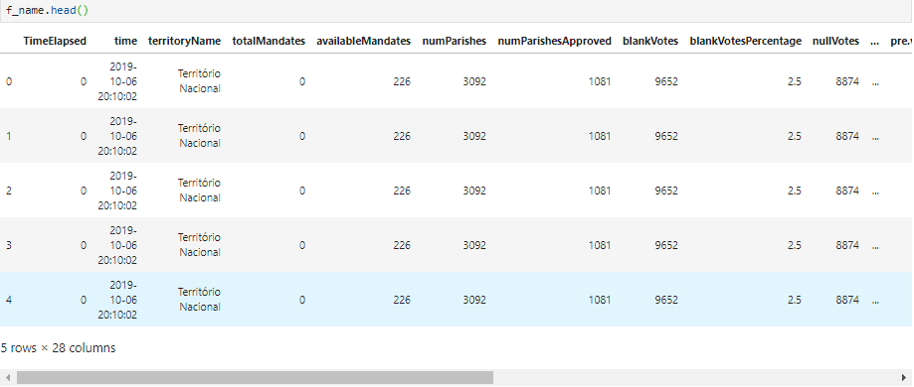
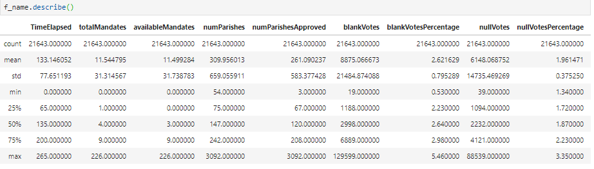
Data understanding

Slide 7
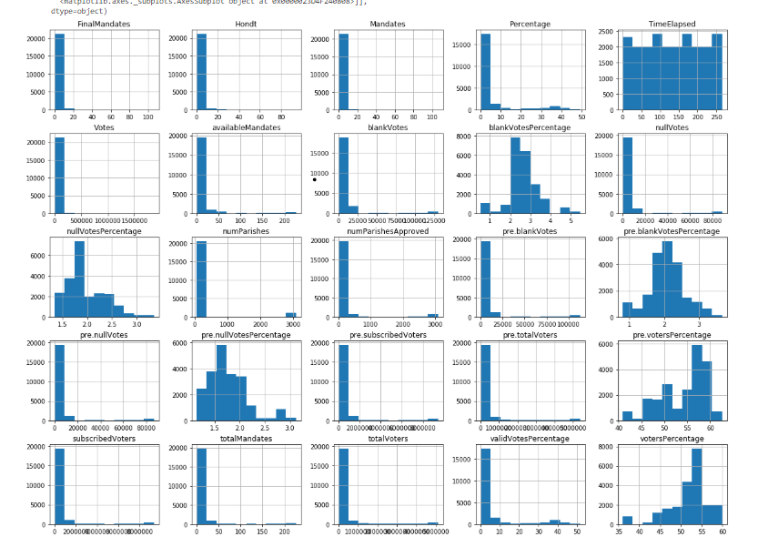
Histogram Plot

Slide 8
Data Preparation
This phase covers activities to finalize the data set. Tables, records or selected attribute are transformed and cleaned for data modelling. This is further used to construct the final data set.
Initial stage: there are some feature which is not required as per our business need, so we removed the feature like ‘Time Elapsed', 'time’, 'total Mandates’, 'Mandates’.
Stage Second: By using LabelEncodeder, we have converted all categorical value into Numerical values and check the null values
Third Stage :Selected the feature which are more suitable for our business objective by using feature Selection and Split the data into Train and test set using Train_Test_split.

Slide 9
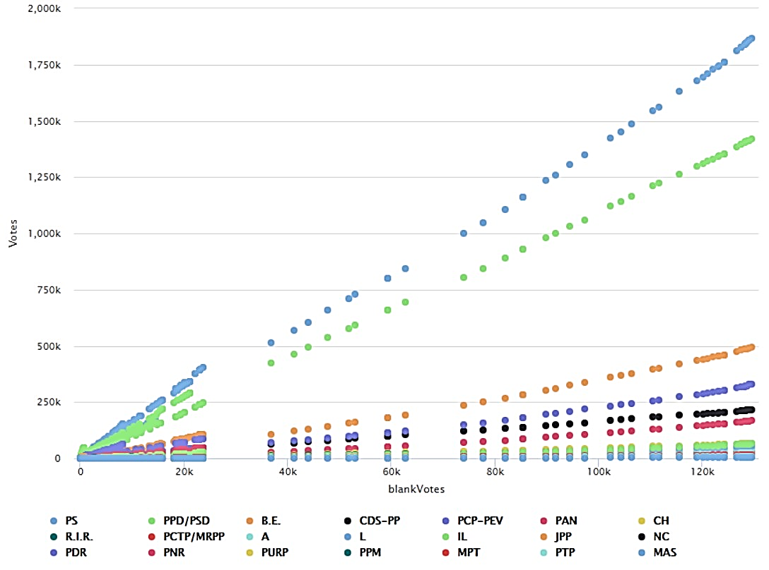
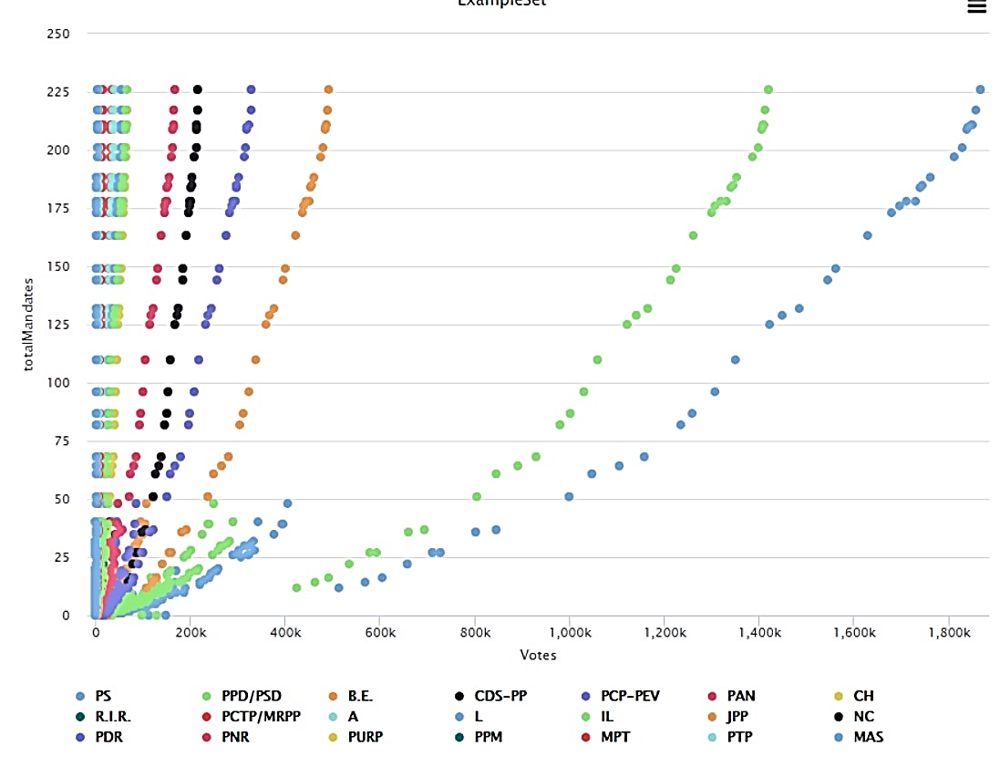
Clustering Visualization
Scatter Plot for blankVots Vs votes
Scatter Plot Votes Vs total Mandates

Slide 10
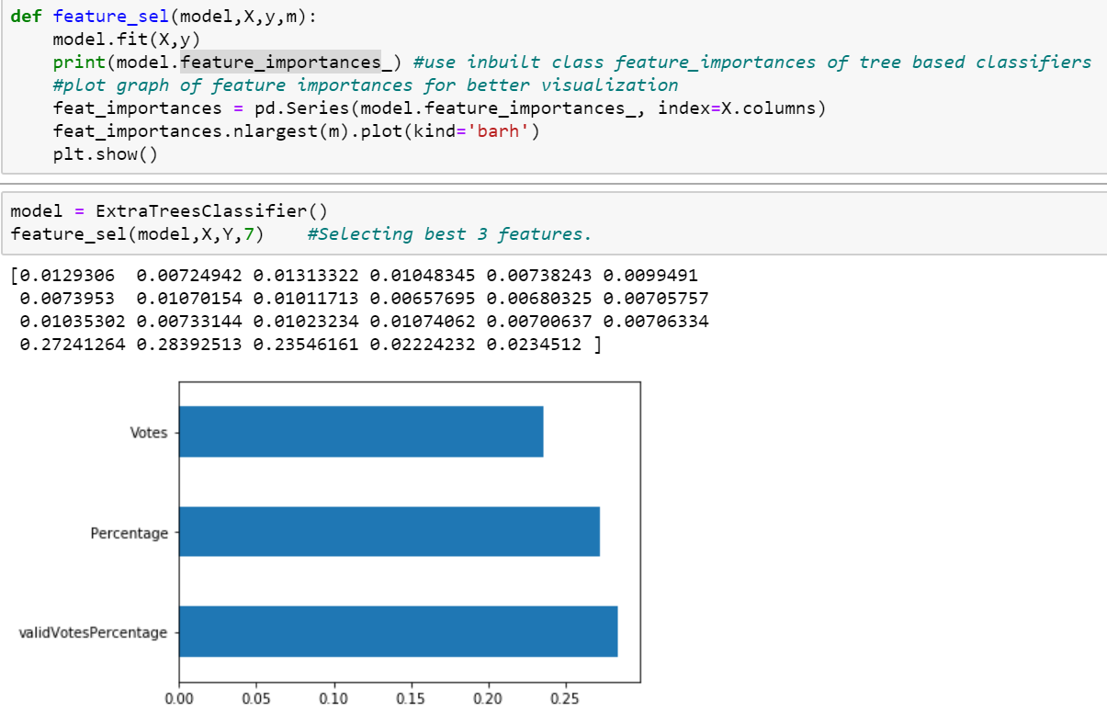
Features Selection

Slide 11
Data Modelling
Suitable modelling techniques are selected and applied to the data and parameters are checked and calibrated to optimal values. Modelling steps includes the following:
Selecting modeling technique
Generate Test Design
Build the mode
Assess the model

Slide 12
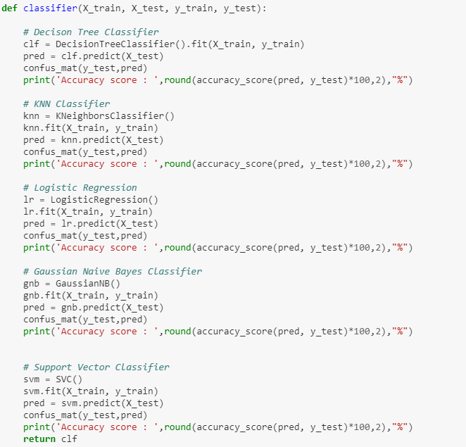
Calculating the Accuracy of the Different Classification Model

Slide 13
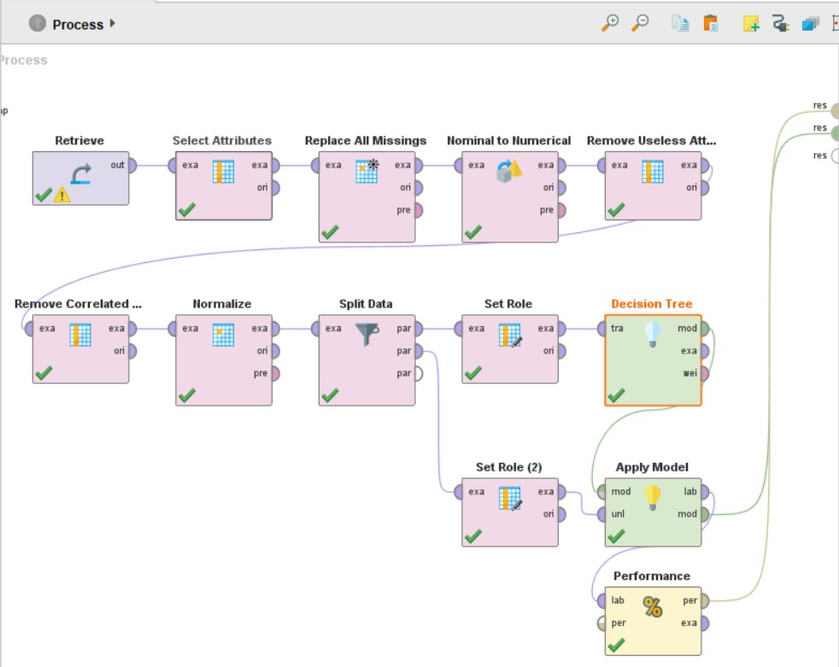
Decision Tree classifier using (Rapid Miner)

Slide 14
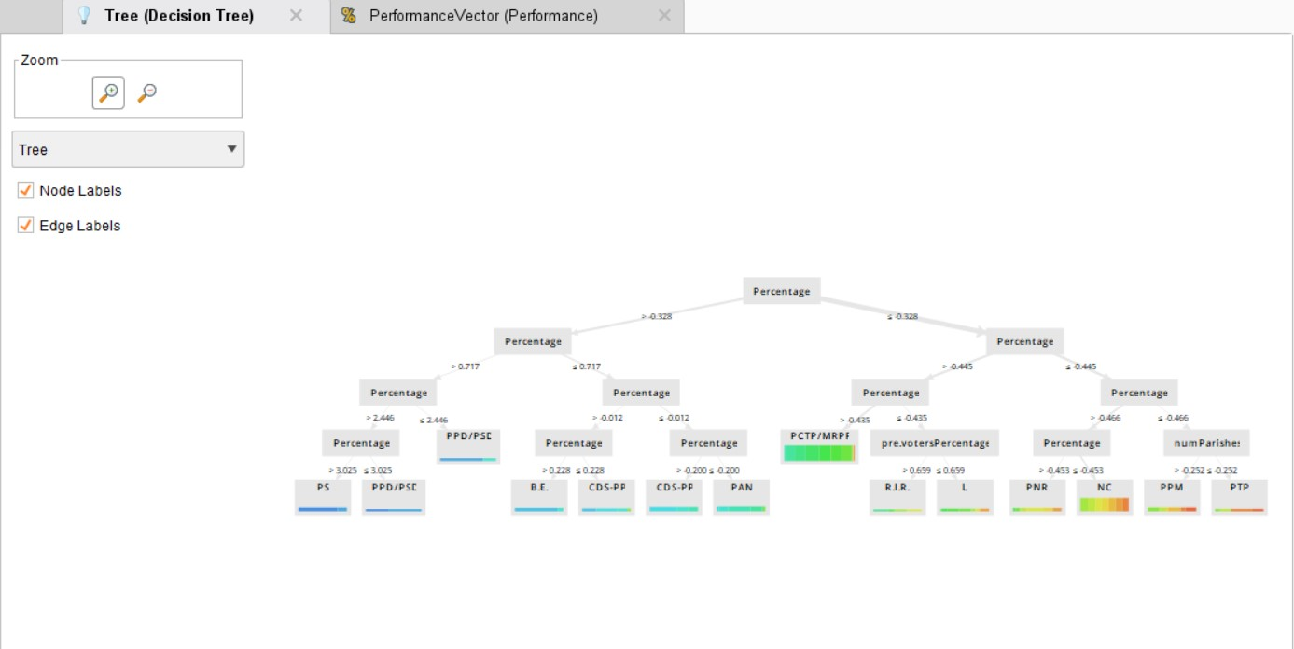

Slide 15
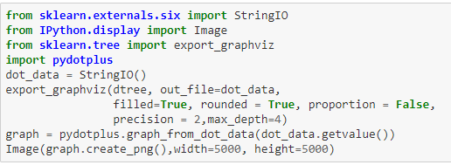
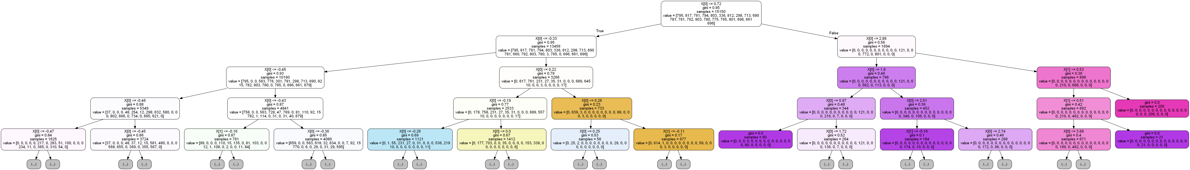
Decision Tree classifier (python)

Slide 16
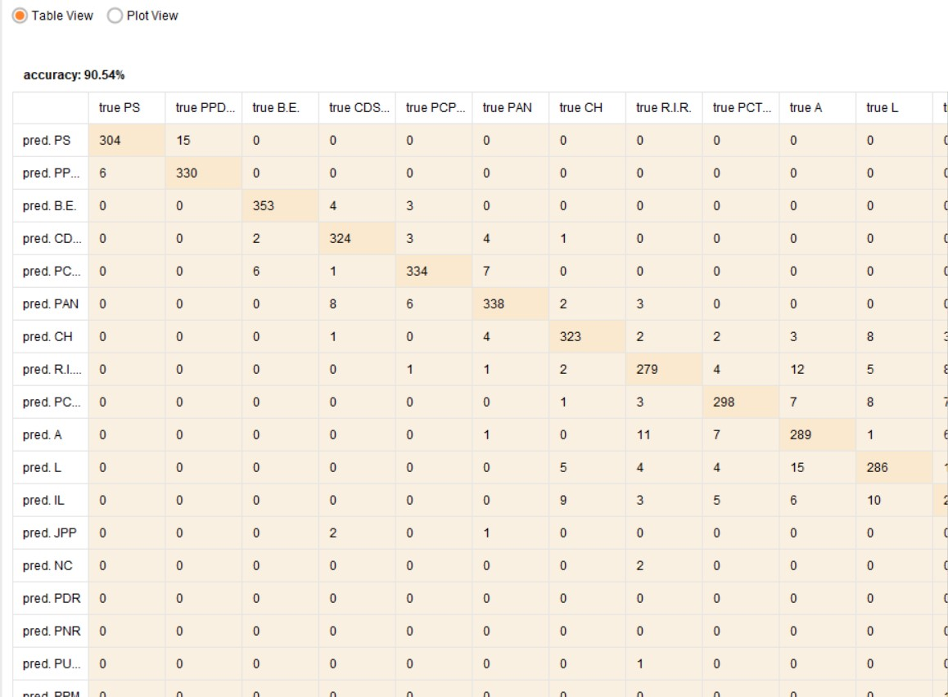
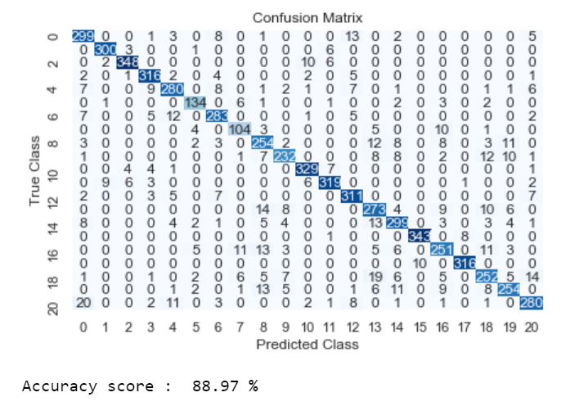
Decision Tree Performance Comparison
Python RapidMiner

Slide 17
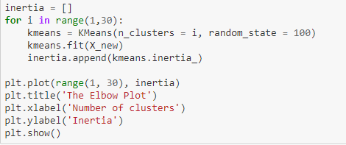
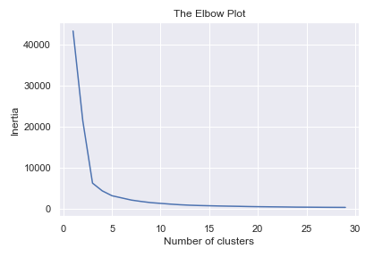
Clustering

Slide 18
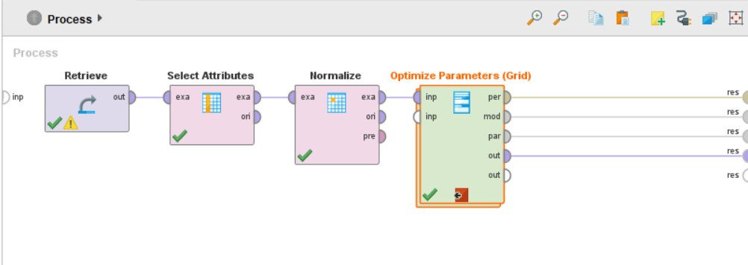
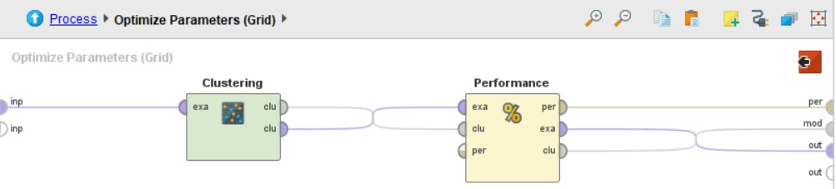
Clustering (RapidMiner)

Slide 19
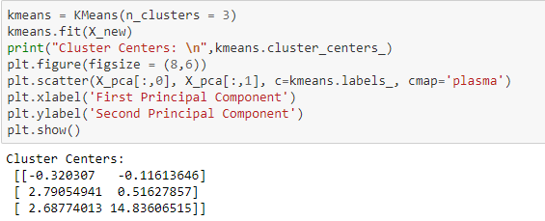
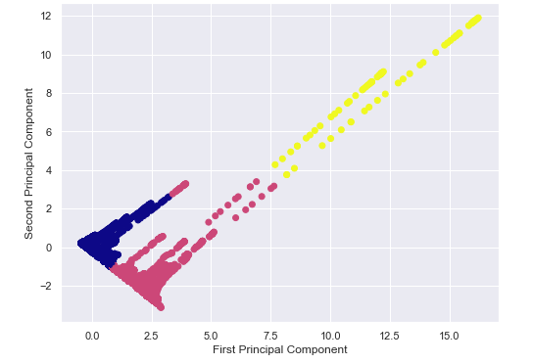
Clustering(Contd.)

Slide 20
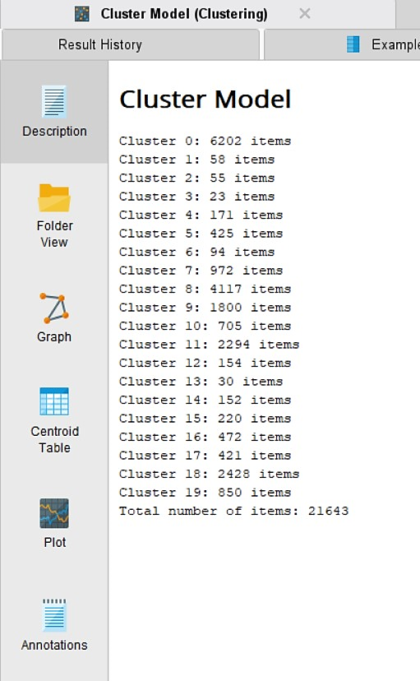
Clustering Model(RapidMiner)

Slide 21
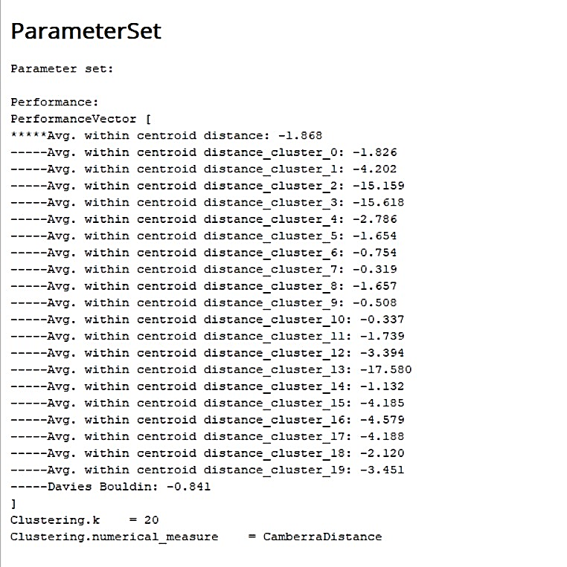
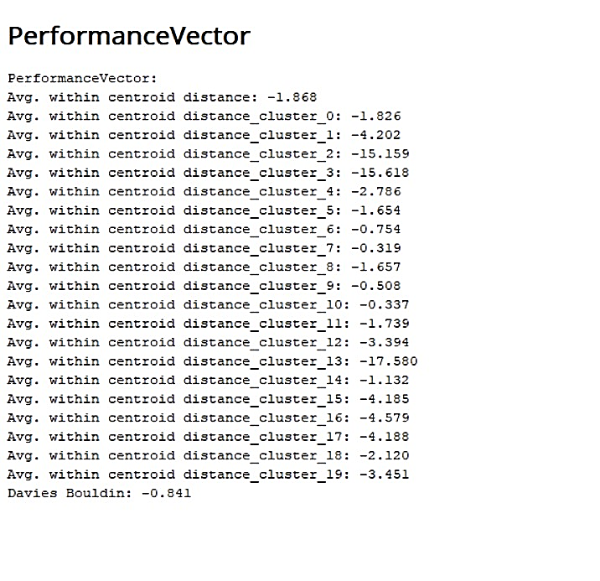
Clustering Parameters &
Performance Vectors

Slide 22
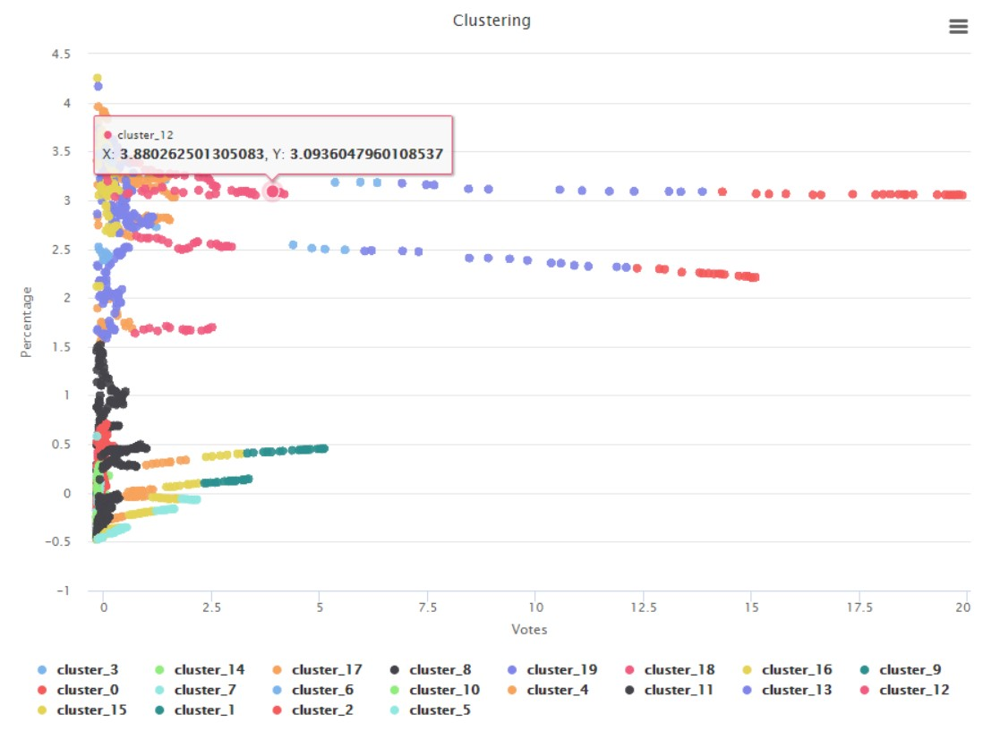
Clustering Result
Scatter Plot

Slide 23
Clustering Visualization
Scatter Plot for blankVots Vs votes
Scatter Plot Votes Vs total Mandates

